Slide 1
U.S. Census Data
2000-2020

Slide 2
Agenda
Overview
Data Wrangling
Data Cleaning
Data Analysis
Retrospective
Q&A

Slide 3
Overview

Slide 4
Goal
Analyze the United States population from 2000 to 2020.

Slide 5






Technologies
Python
Apache Spark
Apache Hadoop
Power BI
Google Drive
Git

Slide 6
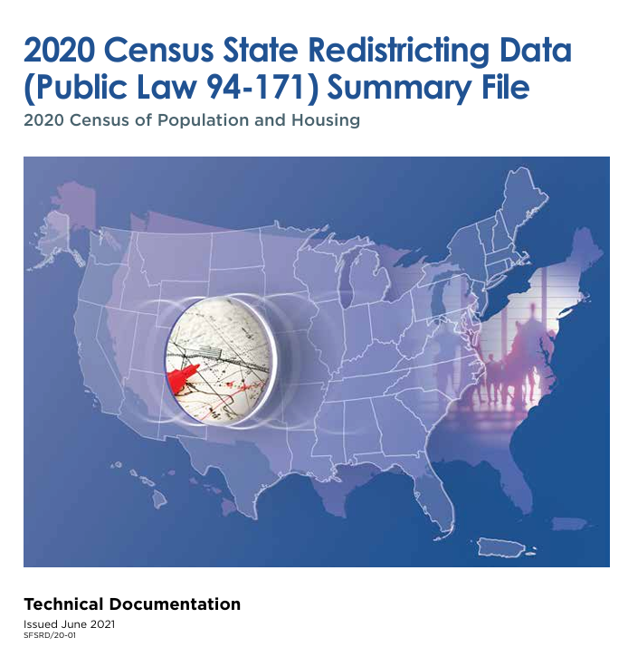
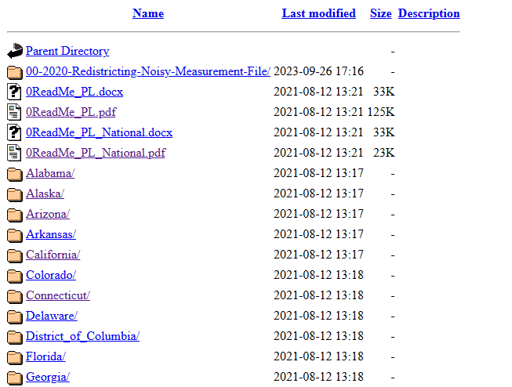
Data Source
Legacy Format Census Data from Census.gov
Requires technical documentation
Census Years
2000
2010
2020
Over 60 million records

Slide 7
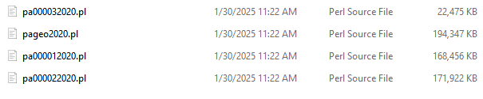
Data Wrangling - Overview
Gather all data from each census year
Utilize documentation to combine state files
Combine all states into one file for each census year
]
pa2020_combined
]
ca2020_combined
ny2020_combined

Slide 8
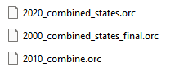
Data Cleaning - Overview
Propose analysis questions
Design final dataset for analysis
Clean and transform wrangler outputs to fit specifications
]

Slide 9
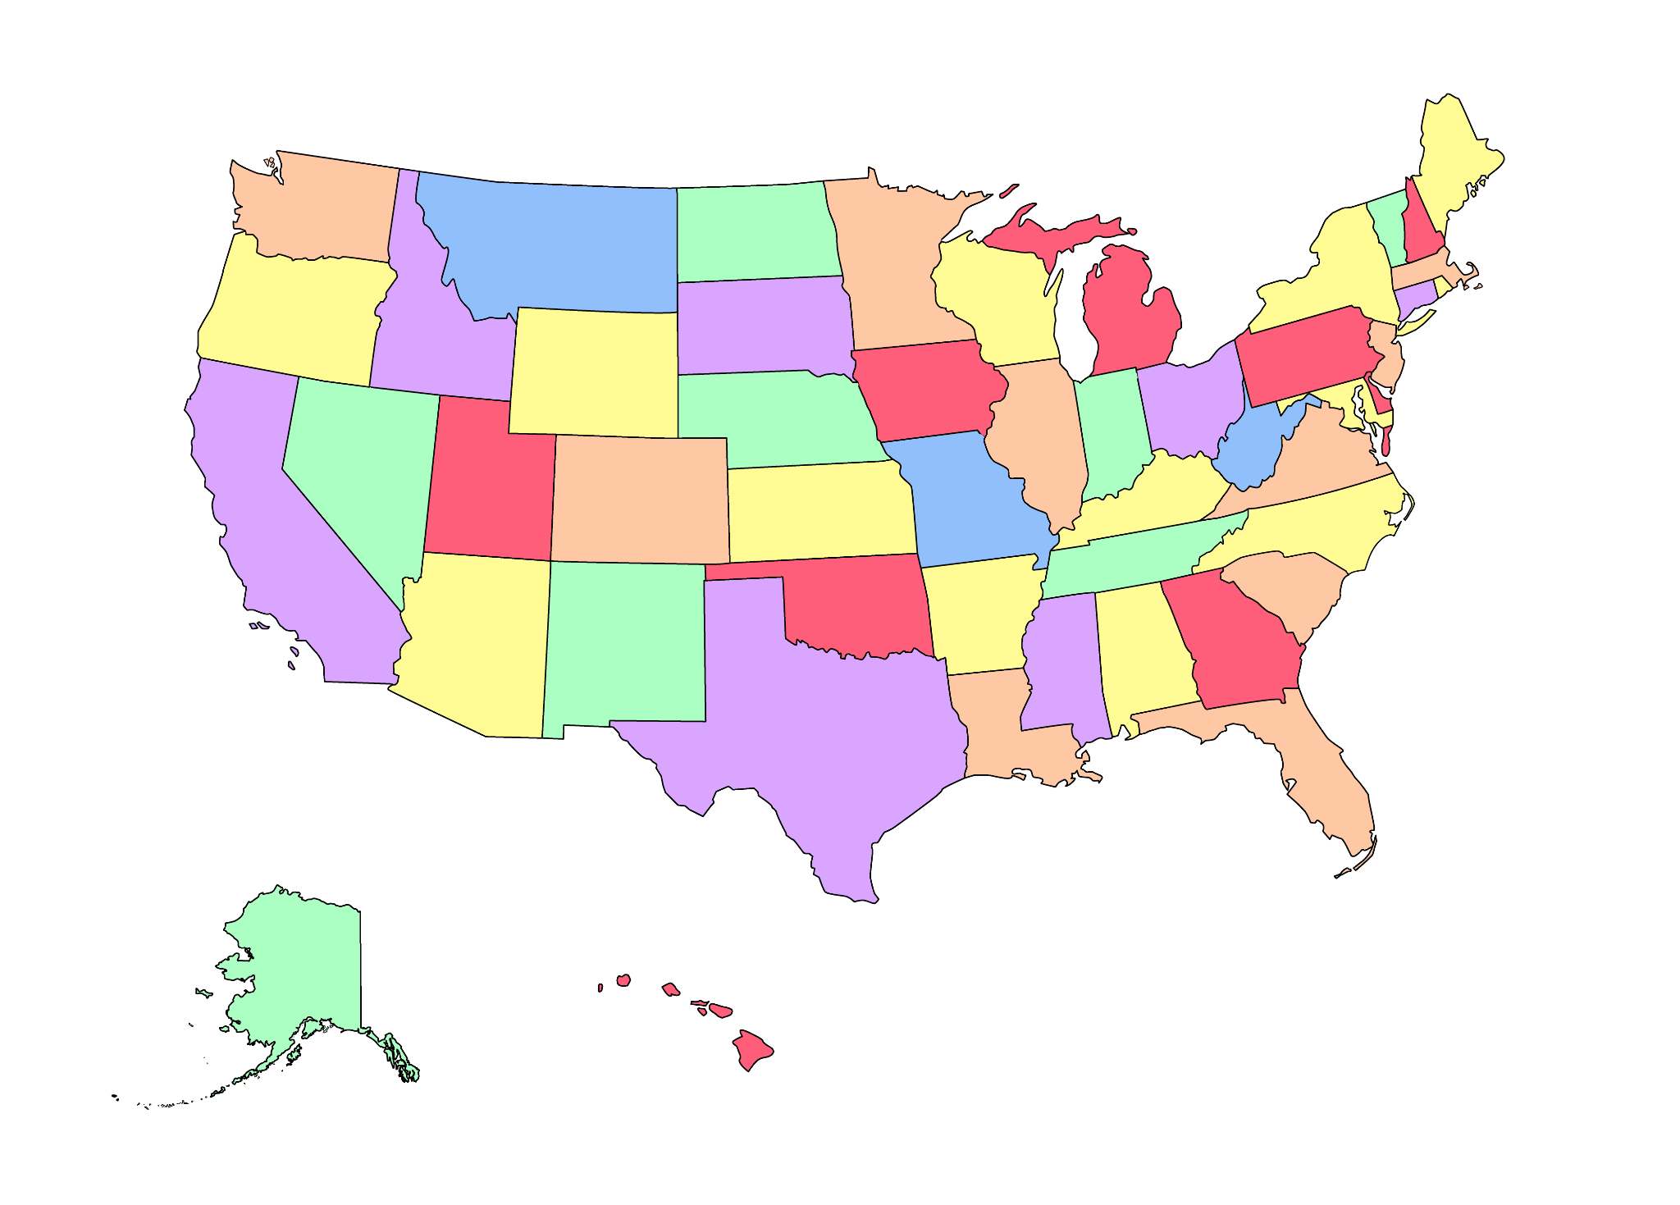

Data Analysis - Overview
Query cleaned data to answer analysis questions
Overall National Trends and Growth
Population Trends and Growth
Demographic Shifts
Regional Comparison
Visualize queries with Power BI
Images Attribution: Vecteezy.com

Slide 10
Team Structure
Wrangler 2020
Analysis
Wrangler 2010
Cleaners
Wrangler 2000
Stage 1
Stage 2

Slide 11
Data Wrangling
Notes:
Hand-off to Aditya (Wranglers 2000 team lead)

Slide 12

Wranglers 2000
Team Members - Rui, Adeel, Tareq and Adit
Team Members - Rui, Adeel, Tareq and Aditya
Group discussion on phases and blockers.
Each member works on all phases independently at first.
Four phases for final dataset - download and parse, combine headers with data, create state files, combine all state files ( one for each member ).
Header parsing with Access (CSV export), then Python solution using access_parser.
Solved Spark memory issues by serialization (Kyro), allocating more driver memory and using ORC format.
Writing the intermediate outputs to files helped facilitate checkpoints.

Slide 13


Wranglers 2010
Wrangled data via Spark and an alternate method with SAS
The contributions from the other wrangling groups were helpful
U.S. Census website provided SAS documentation which was helpful
Had great contributions from all members in various forms such as code, documentation, notes, and analysis
Eventually had two copies of the final dataset due to two different methods being used
One dataset was smaller in file size than the other (both saved in the optimized ORC format)
Coordinated with the Cleaners to drop certain duplicated columns

Slide 14
Wranglers 2020
At first, the states were divided evenly between four people
Merging the data manuals seemed achievable at first between four people
A blocker came up since spreadsheet programs had trouble loading the large data files
It was decided to switch to merging the data programmatically
Ultimately, the 2000 Wrangler team’s merger programs were adapted to work with the 2020 data files

Slide 15
Data Cleaning
Notes:
Hand-off to Miguel (Cleaners team lead)

Slide 16
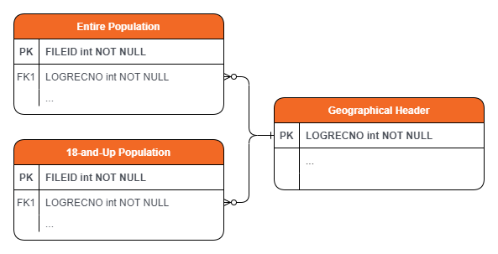
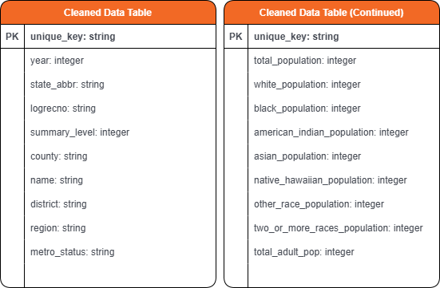
Cleaners
Cleaners Team
Miguel - Team Lead
Eric Hom
Kimberly Hilke
Maxine Shi
Summary Levels:
40 - State Level
50 - County Level
160 - City Level
500 - District Level
Designed loader and cleaner classes that follow SOLID principles and OOP design.
Responsible for providing the entire team a clean dataset which can be queried for relevant data to each analysis question.
Notes:
Out of more than 350 columns, we decided to keep 19 columns and 4 summary levels of data based on a set number of analysis questions, we simply dropped irrelevant fields. The original dataset was close to 30 GB for each decade.

Slide 17
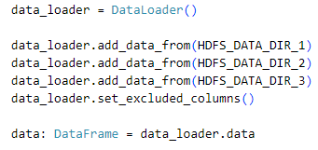
Data Loader Class
Data Loader Class
loads each decade’s data
union on common columns
add back differences
return a single DataFrame
Abstracts away pySpark implementation details, executes only when getter is accessed
Utilized HDFS since each dataset was over 3GB in size
Scales horizontally as a result

Slide 18
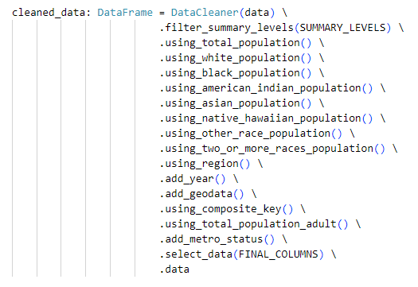
DataCleaner Class
Cleaner Class
take in large DataFrame
filter rows on summary levels of interest
rename important columns and set appropriate data type
select on important columns
return a single clean DataFrame less than 4MB in size
Each method call returns an object of DataCleaner class, allowing them to be chained together
Once an action is called, the Spark Catalyst Optimizer takes over and quickly performs the necessary transformations.

Slide 19
Analysis Question Overview
Overall National Trends and Growth
What is the total population trend and growth rate from 2000 to 2030?
What is the overall change in racial composition of the USA from 2000 to 2030?
Population Trends and Growth
What are the population growth rates for each state from 2000 to 2020? Which states had the highest and lowest growth rates between census years?
Which districts experienced the highest population growth and decline rates between census years?
What districts have consistently been the most populous across the three census years?
What percentage of districts experienced population stagnation?
Which districts experienced the highest decline and growth rates of the adult population (18+) across the three census years? Youth population?
Which cities have held the highest proportion of adults vs youth population across census years?
Which counties have remained the most stable in terms of adult vs youth population ratio across census years? What percentage of counties are stable vs highly changing?
Notes:
Do not read them all out loud, waste of time. Simply provide an overview like “These will be the questions we will be answering, name the categories, and note the number and how each question can be answered with the clean dataset”

Slide 20
Analysis Question Overview
Demographic Shifts
What are the trends in racial composition in CA, NY, TX over the 20 years?
Which racial group experienced the most significant growth (as a percentage of total population) in each state?
How did racial majorities in districts shift across the census years? Which districts had a significant shift in racial majorities/minorities?
What is the correlation between racial diversity and population growth in districts? How does it compare to the national trend in racial diversity?
Regional Comparison:
How does population growth vary by geographic region?
Are there significant differences in racial composition trends among regions?
What regions showed the fastest racial diversification from 2000 to 2020?
How do population growth rates in metropolitan districts compare to non-metropolitan districts?
Which regions saw the greatest increase in minority population share?
Notes:
Manager introduces Data Analysis section

Slide 21
Data Analysis
Overall National Trends and Growth
Notes:
Hand off to Miguel to start analysis section

Slide 22
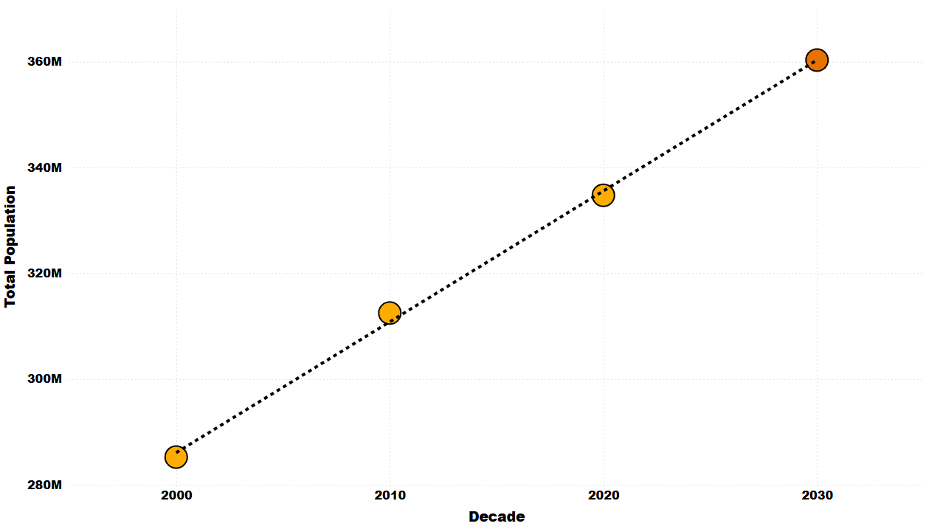
Projected Total US Population
2000: 285M
2010: 312M
2020: 335M
Projected 2030: 360M
Simple Linear Regression model used to predict 2030 population.
Notes:
Projected population in 2030 will exceed 360M, calculated with simple linear regression. The relationship between decade and population was assumed to be linear.

Slide 23
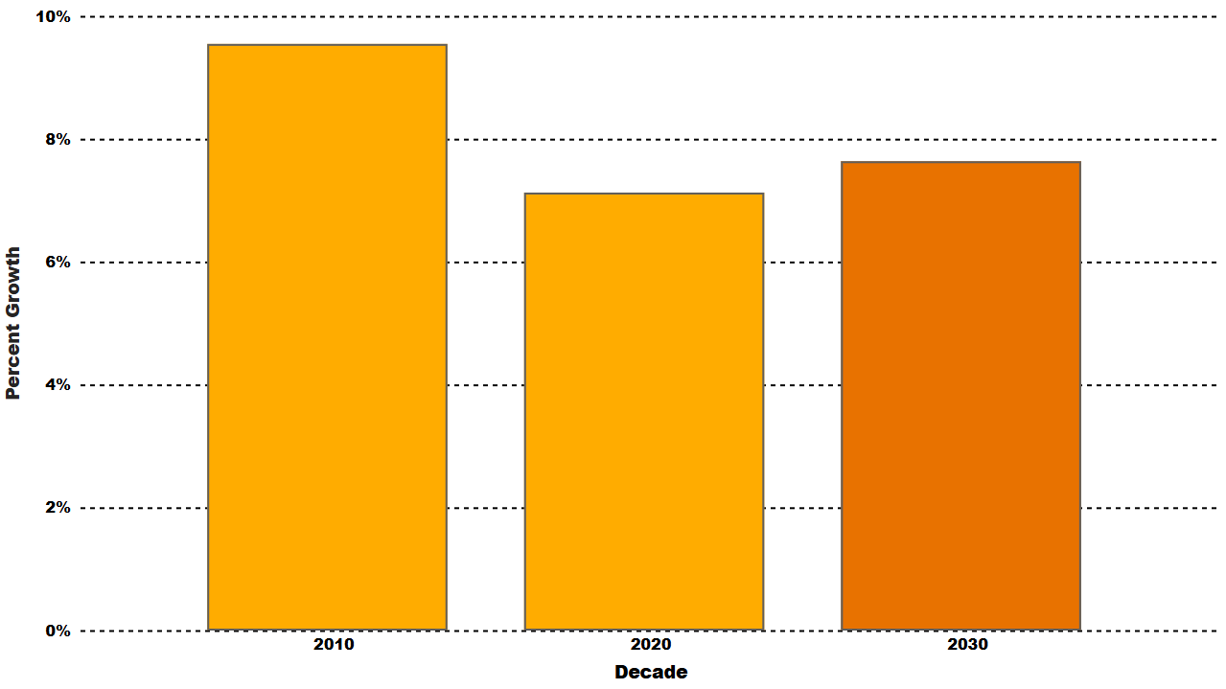
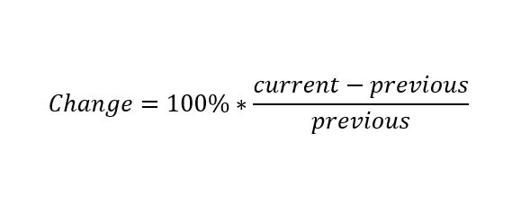
Total Population Growth Rate Over 30 Years
2000-2010: 9.55% growth rate
2010-2020: 7.13% growth rate
2020-2030: 7.64% growth rate
Percent change formula used to calculate growth rate:
Notes:
Percent growth was calculated with (total_population - prev_population)/prev_population, but we did not have data for 1990, so the growth rate was calculated for 2010, 2020, and 2030, where we see a drop after 2010 with a slight recovery..

Slide 24
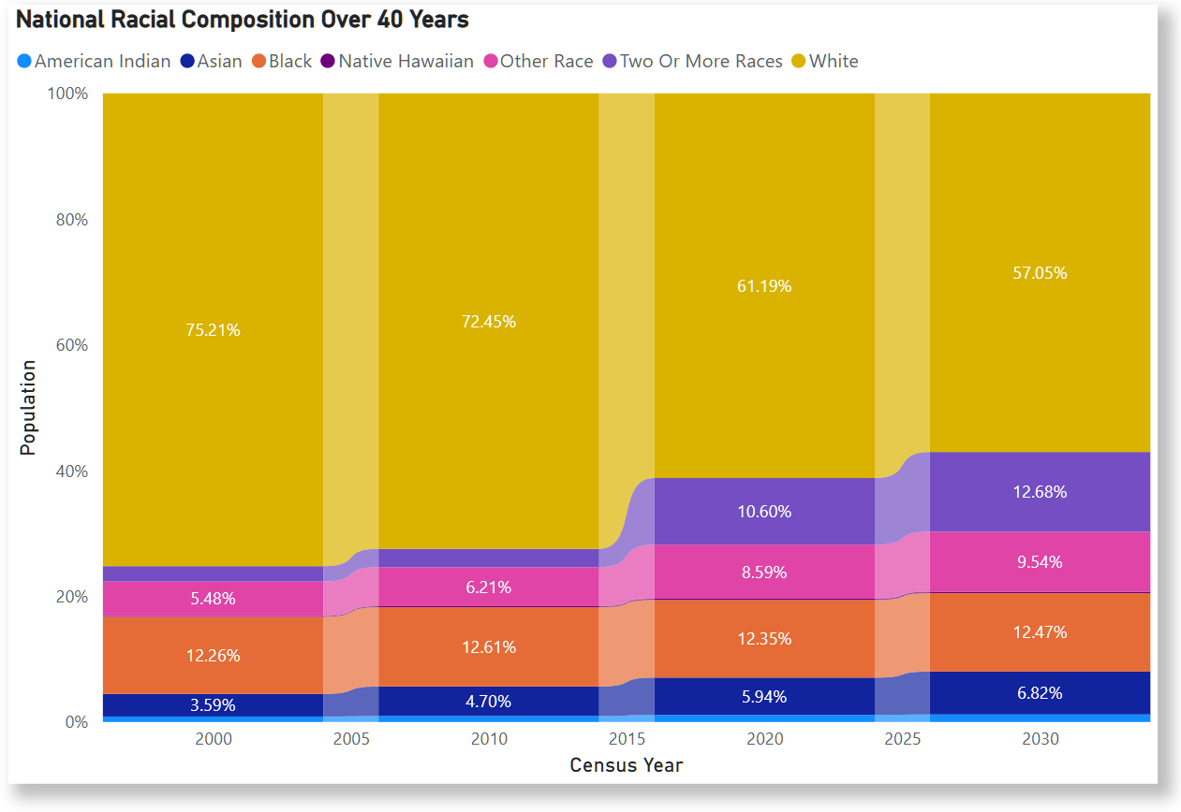
Racial Composition Over 40 Years Nationally
Overall, the U.S. experienced similar demographic shifts across each census year.
The White demographic continues to shrink while all other demographics see an increase of various amounts.
Using linear regression, a prediction was made for the racial composition of the U.S. in 2030.

Slide 25
Data Analysis
Population Trends and Growth
Notes:
Hand off to Tareq to start analysis section

Slide 26
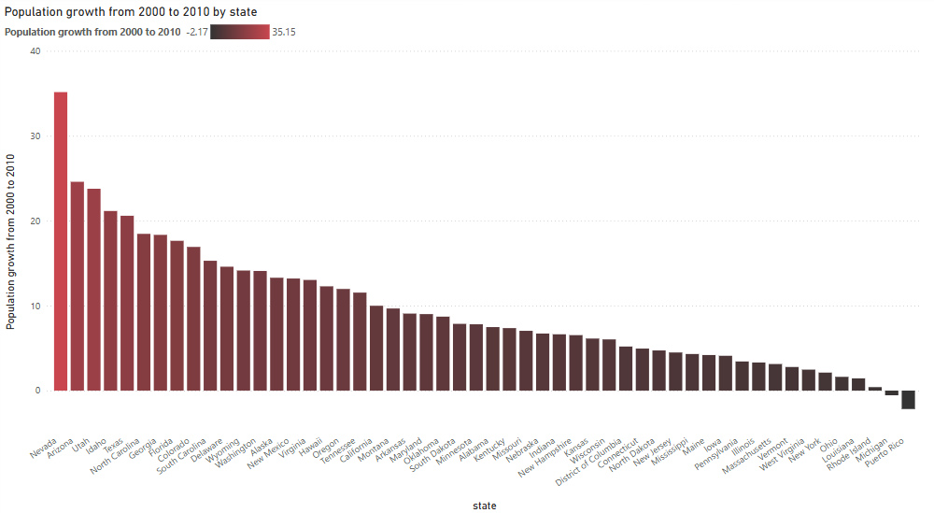
Population Growth From 2000 to 2010 By State
Nevada has the highest growth rate from 2000 to 2010 at 35.15%
~ 700,000 increase
Puerto Rico has a negative growth rate at -2.17% from 2000 to 2010
~ 82,000 decrease

Slide 27
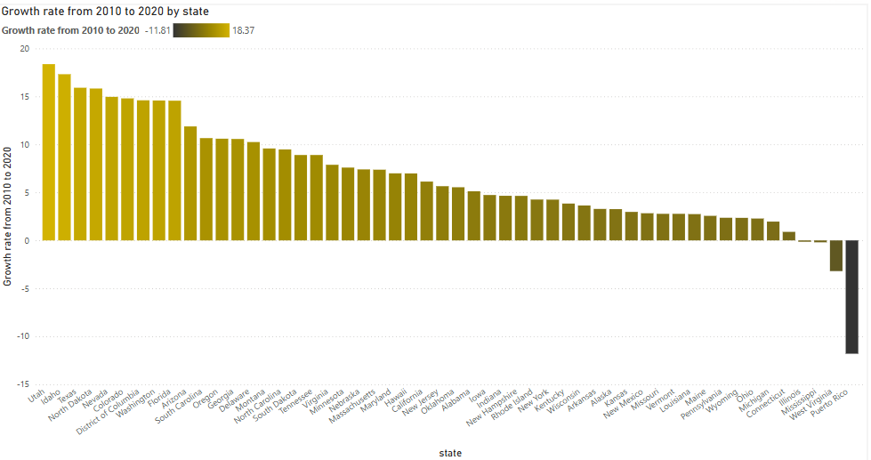
Population Growth From 2010 to 2020 By State
Utah has the highest population growth at 18.37% from 2010 to 2020.
~ 500,000 increase
Puerto Rico has a negative growth rate at -11.81% from 2010 to 2020.
~440,000 decrease

Slide 28
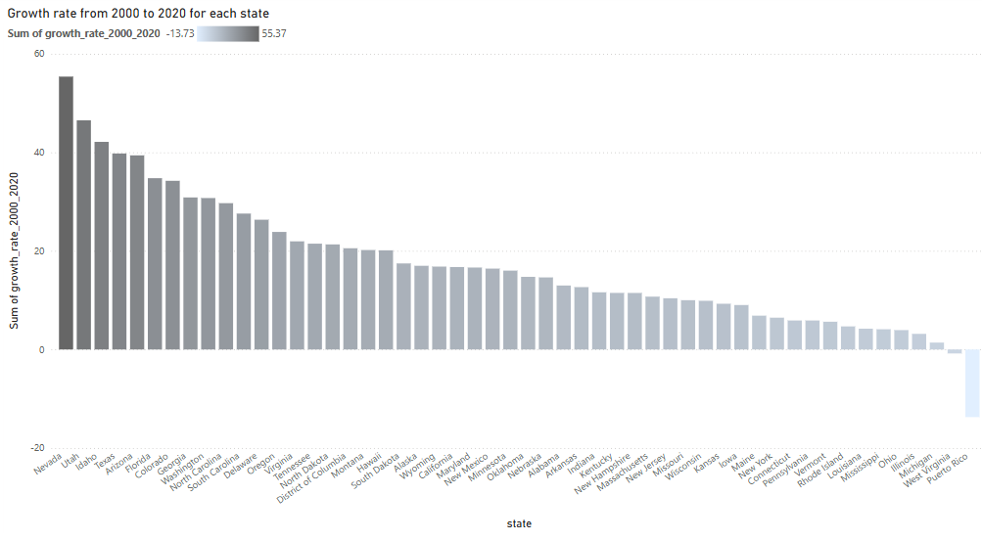
Population Growth From 2000 to 2020 By State
Nevada has the highest percentage growth at 55.37%.
~ 1.1 million increase
Puerto Rico has a negative growth rate at -13.73%.
~ 500,000 decrease

Slide 29
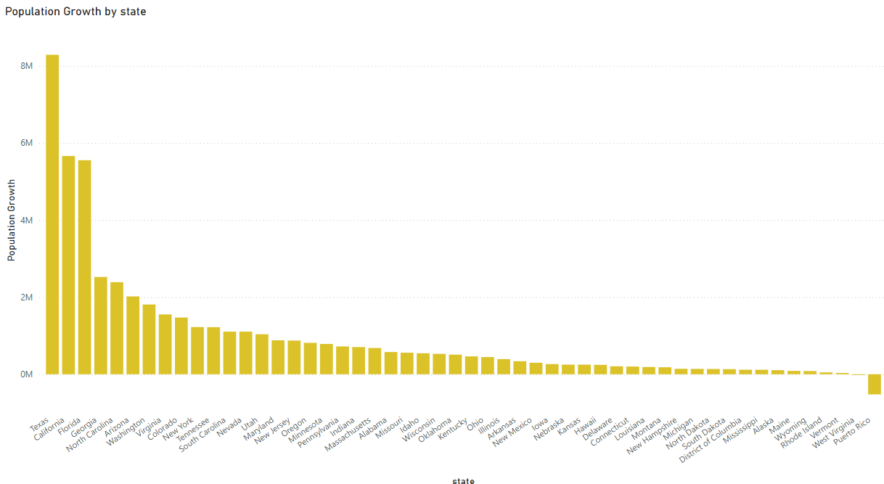
Population Growth From 2000 to 2020 By State (Total)
Texas has the highest population growth based on the amount of people (39.77%, ~8 millions)
Reasons: Lower cost of living, more job opportunities, warmer climate, no state income tax, high birth rate
Puerto Rico has negative population growth
Reasons: Cost of living has risen, low birth rate, natural disasters (Hurricane in 2017 & 2022), limited federal support

Slide 30
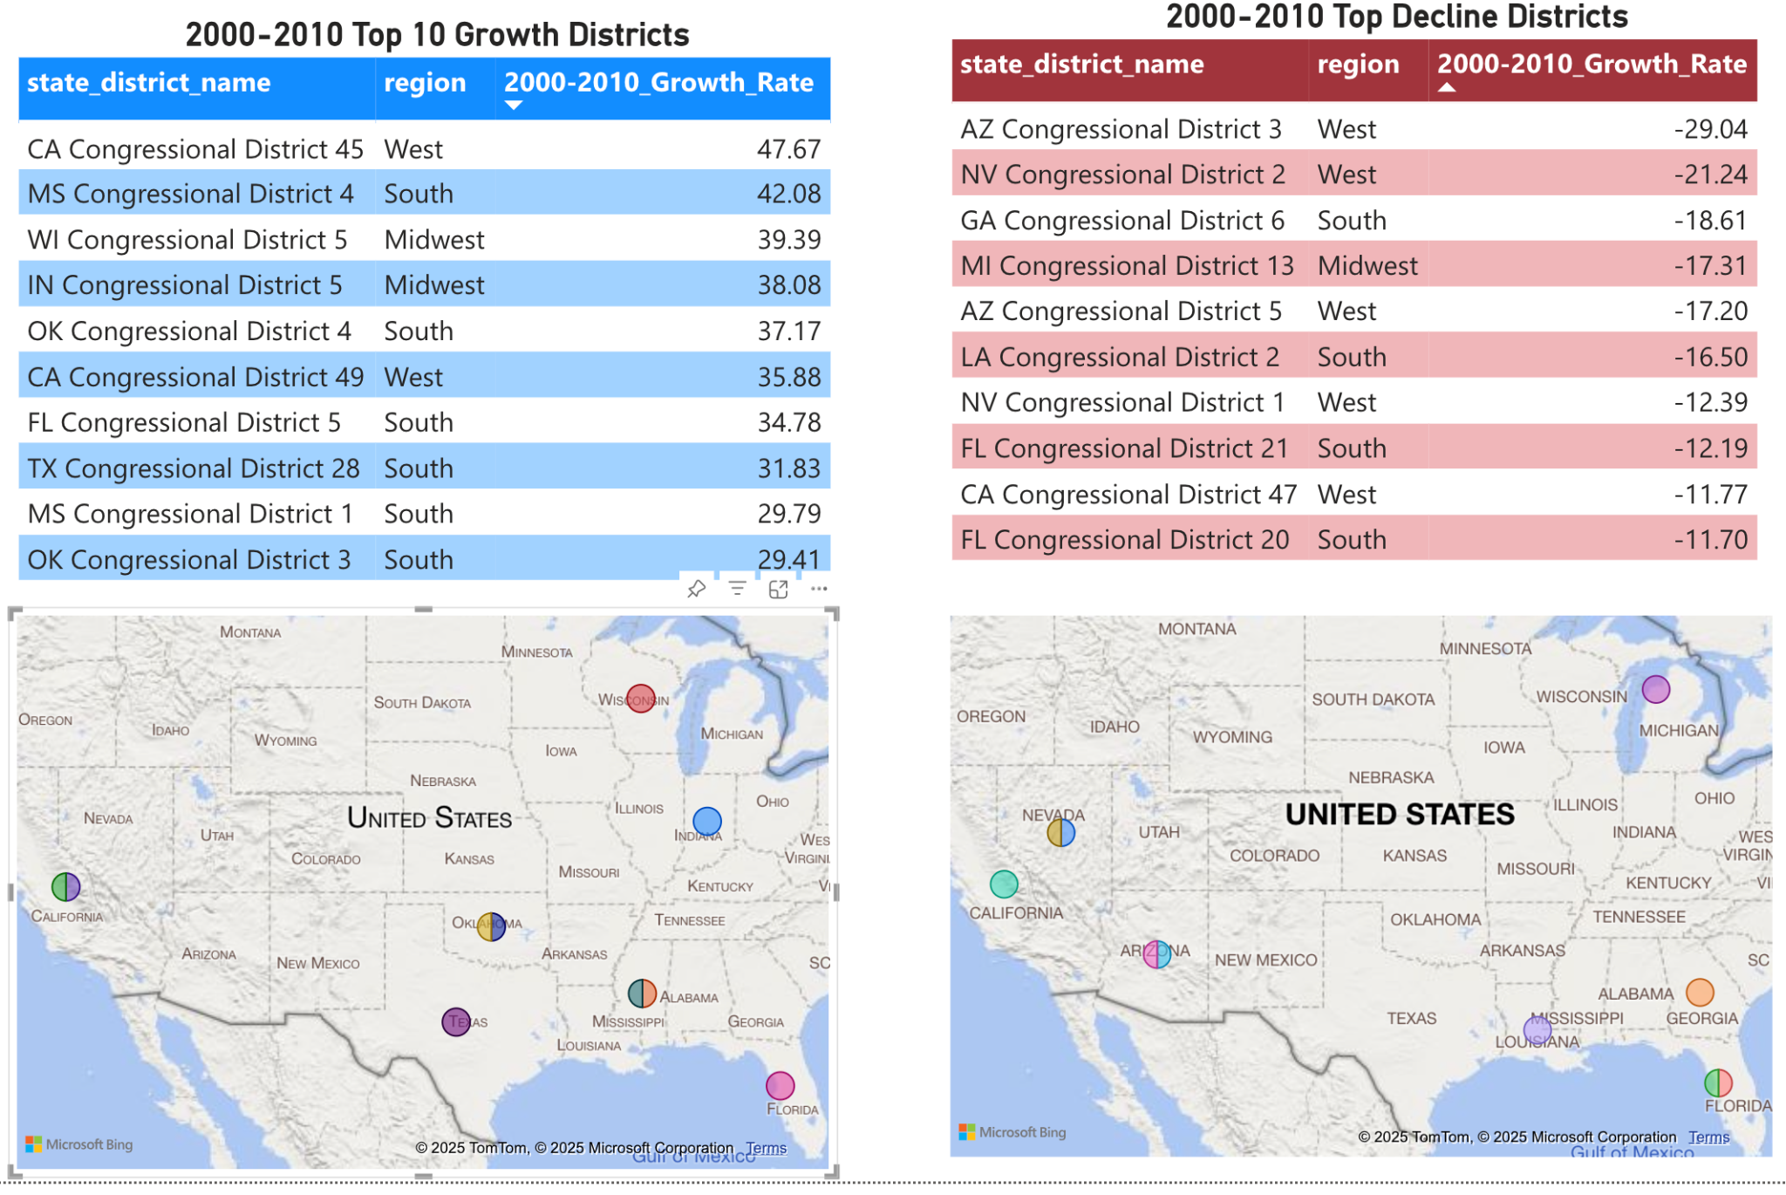
Population Growth and Decline Rate by District From 2000 to 2010
Notes:
Henry

Slide 31
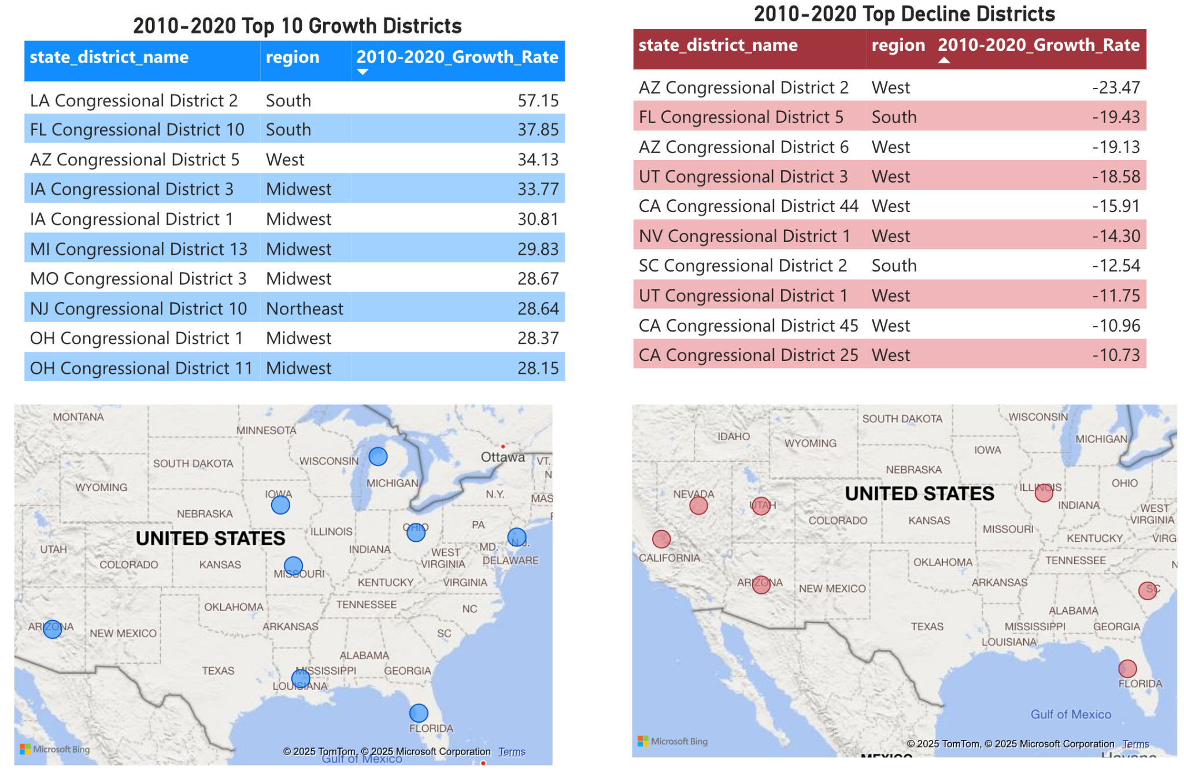
Population Growth and Decline Rate by District From 2010 to 2020
Notes:
Henry

Slide 32
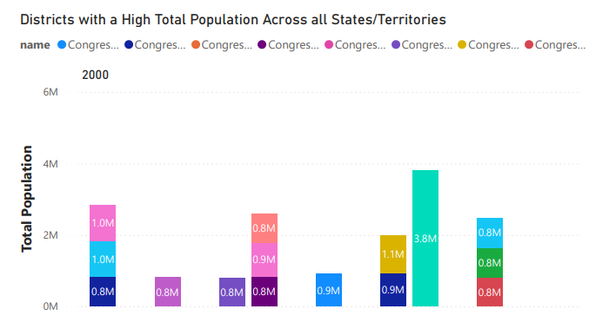
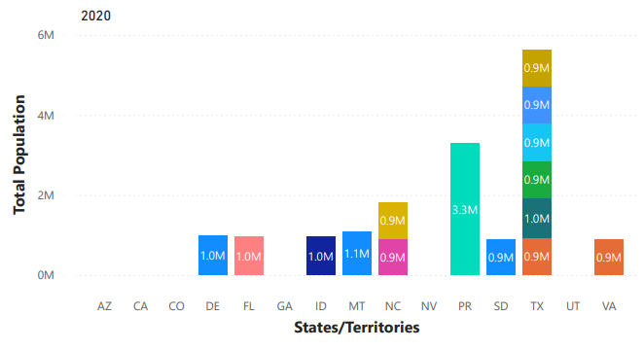
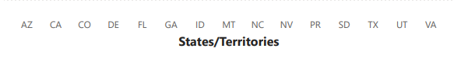
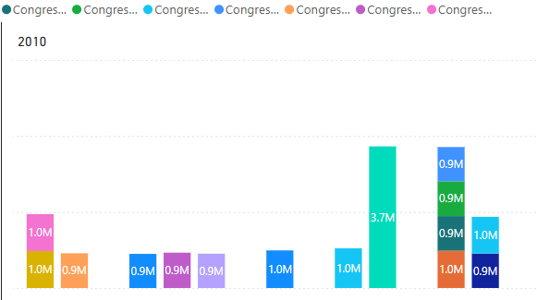
Districts with High Population Across Three Census Years
Over the past 20 years, the population of Puerto Rico’s Resident Commissioner District has decreased, though it remains the most populous district in the United States.
Several of Texas' districts rank among the most populous in the country.
Montana has consistently ranked as one of the most populous districts, likely due to having only one congressional district and a steady population increase.

Slide 33
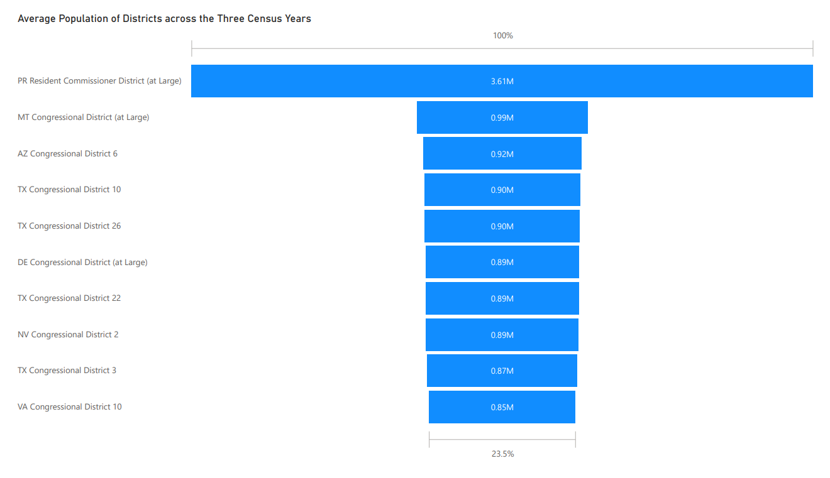
Average District Population Across Three Census Years
The average population over three census years includes multiple Texas districts, reinforcing the growth trend.
Virginia, Delaware Arizona and Nevada have had districts with high average populations, suggesting that their populations have been very slowly increasing compared to all U.S. districts.

Slide 34
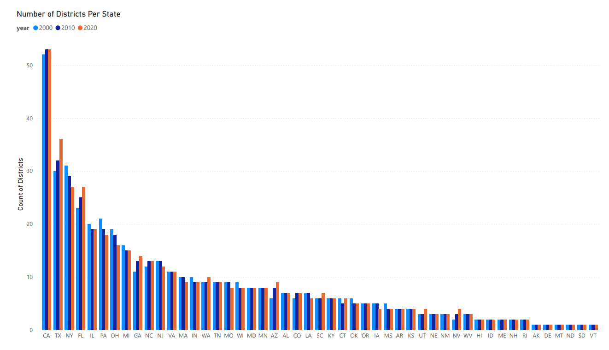
Number of Districts per State
States such as TX, FL, GA, WA, AZ, SC, NV, and UT have consistently added new districts, likely due to higher economic activity and increased opportunities driving population growth.
On the other hand, states like PA, OH, MA, and NY have seen a consistent shrinkage in the number of districts, which may be attributed to factors like out-migration, an aging population, high cost of living and fewer economic opportunities leading to slower growth or declining population

Slide 35
Conclusions/Final Thoughts
Consistent Increase in district population - an indication of higher economic activity.
Decrease in district population - could indicate redistricting or out-migration.
Redistricting - to ensure equal legislative representation of the population in a state.
A sharp increase in one district may lead to redistricting in a state which may increase or decrease a district’s population.
In Texas - population growth has led to the creation of new districts, which, over time, have become one of the most populous.
Newer districts in growing cities like Houston, Dallas, Austin, and San Antonio may consistently rank among the most populous.
States that have seen larger increases in both population per district and the number of districts are likely experiencing an overall upward trend.

Slide 36
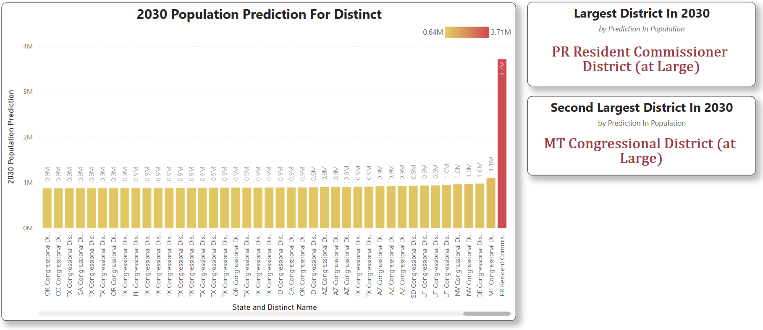
Population Prediction For 2030 Per District
Puerto Rico forms a single, unique district covering its entire population.
Excluding Puerto Rico District, the predicted population distribution across other districts in 2030 is fairly even, aligning with U.S. districting principles.

Slide 37
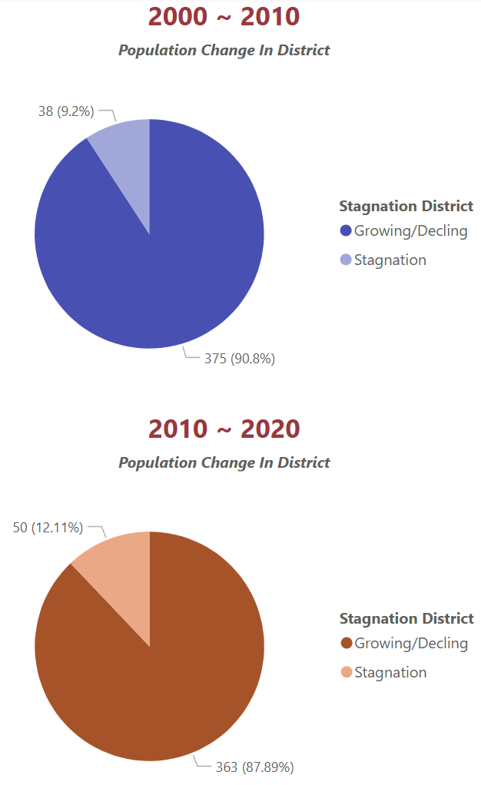
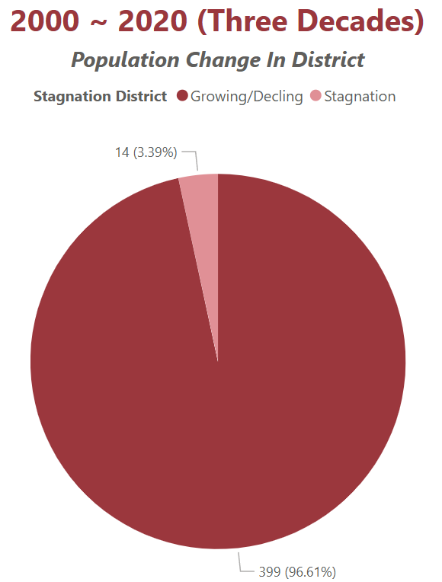
Districts Experienced Population Stagnation
Population Stagnation Criteria: Population change rate <2%
2000–2010: 9.2% of districts experienced stagnation.
2010–2020: 12.11% of districts experienced stagnation.
2000–2020: 3.39% of districts experienced stagnation.
Conclusion: Each decade shows a higher proportion of stagnant districts, but over 3 decades, the proportion of stagnation significantly decreases.
This aligns with the U.S. redistricting principle of adjusting districts every decade to maintain equal population distribution, allowing for more evident long-term population growth.

Slide 38
Data Analysis
Demographic Shifts

Slide 39
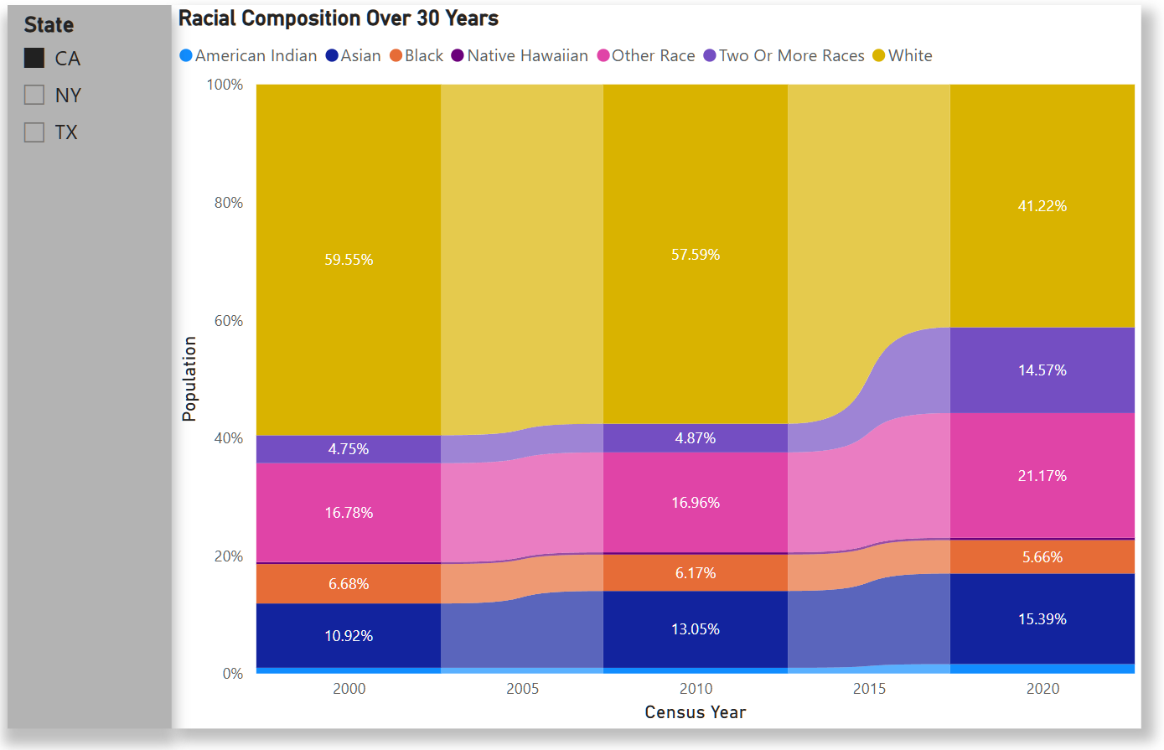
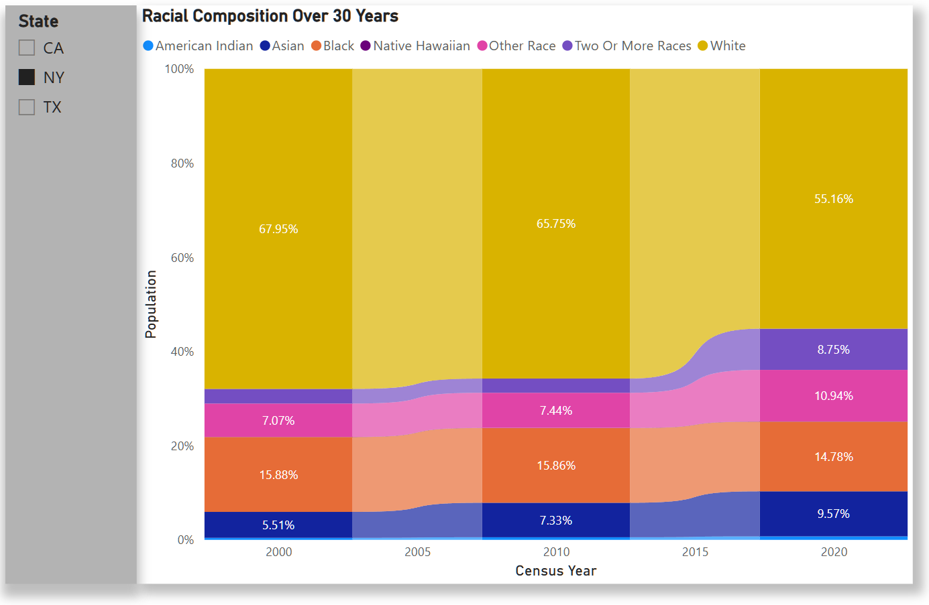
Racial Composition Over 30 Years By State
For California and New York, the data shows a large shrinkage in the White demographic. All other demographics saw increases with the exception of Black which saw a small decrease.

Slide 40
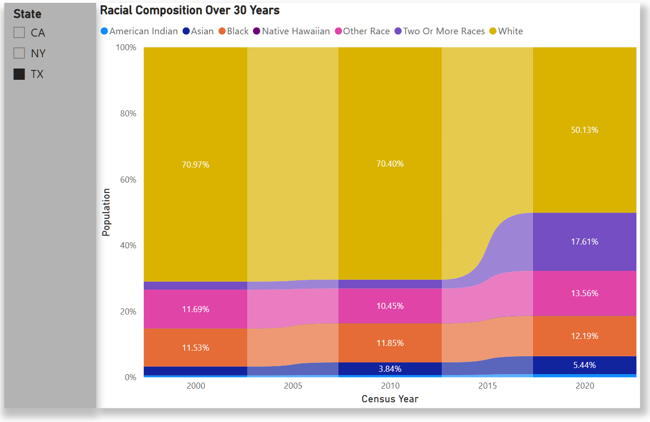
Racial Composition Over 30 Years By State
For Texas, the White demographic saw a massive shrinkage of 20% between 2010 and 2020 while most other demographics saw a small increase.
The Two Or More Races demographic saw the biggest increase between 2010 and 2020, jumping up by 15%.

Slide 41
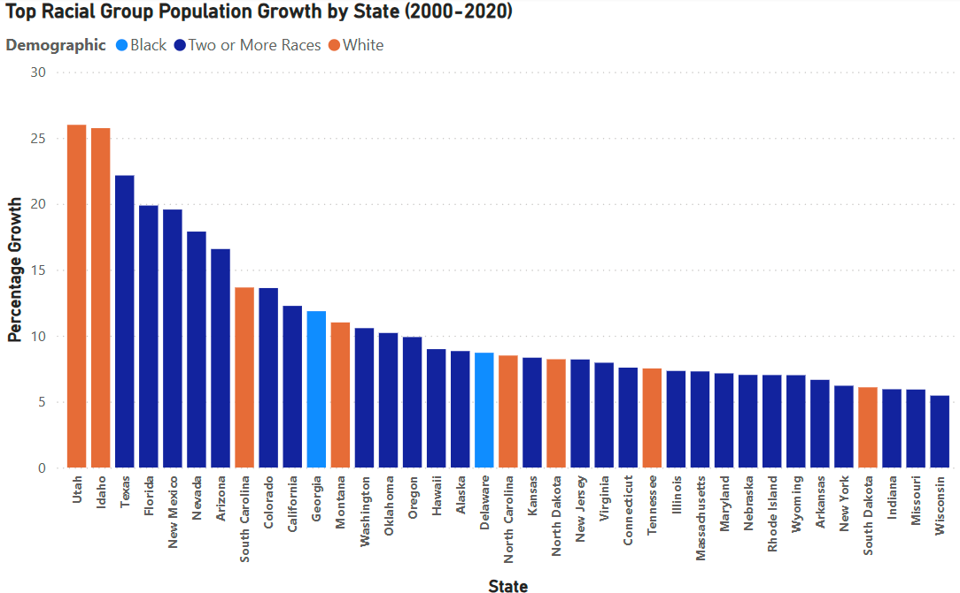
Racial Group Growth By State (Total Population)
Three categories categories across all state.
Top white population growth was Utah at 26.99%
Top black population growth was Georgia at 11.81%
Top multiracial growth being Texas at 22.16%
Overall 40 states had multiracial as their top growing racial group, 8 states had white and 2 states had black

Slide 42
Racial Group Data Insight
Two or More Races State Trend
Increased social acceptance of multiracial identities
Increase in interracial marriage and relationships
White State Trend
High concentration of the racial group.
Example: Both Idaho and Utah population is 80% white
Black Trend
Social influence
Example: Atlanta Georgia is considered a hub for african american entrepreneurs
Potential Data Skew
Individuals can choose their what racial group they identify as.
United States does not identify Latino/Hispanic as a racial group even though they equate to roughly 18% of the population.

Slide 43
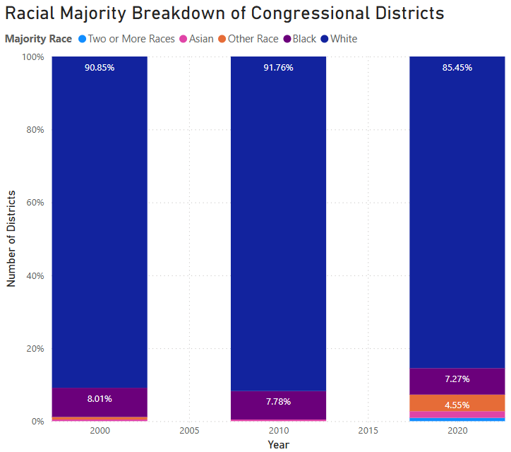
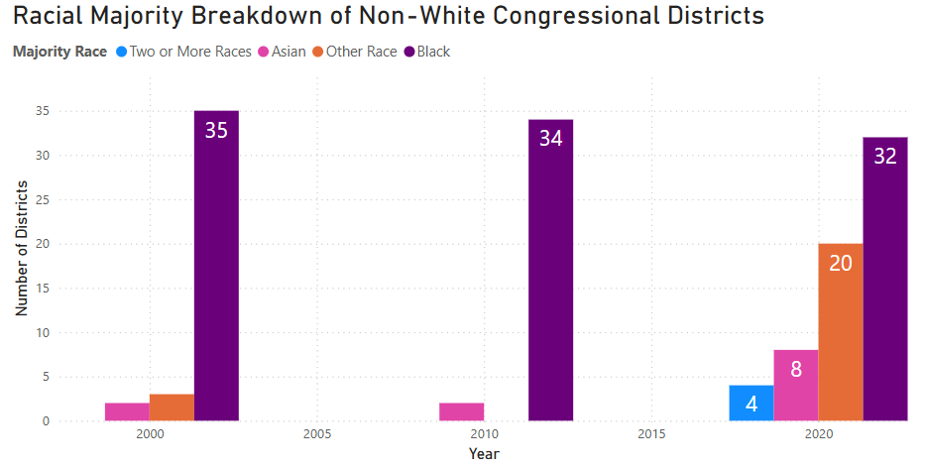
Shifts in District Racial Majorities
Most districts in the US are white majority, but there was a significant increase in non-white majority districts for 2020
64 non-white majority districts in 2020, compared to only 40 in 2000

Slide 44
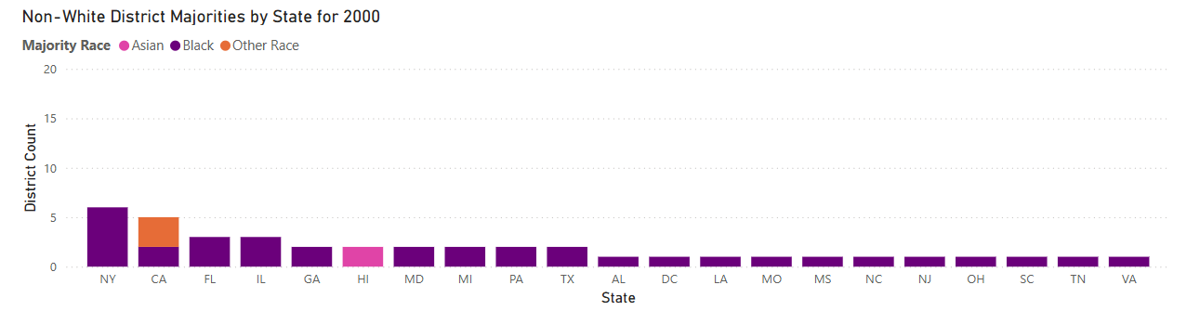
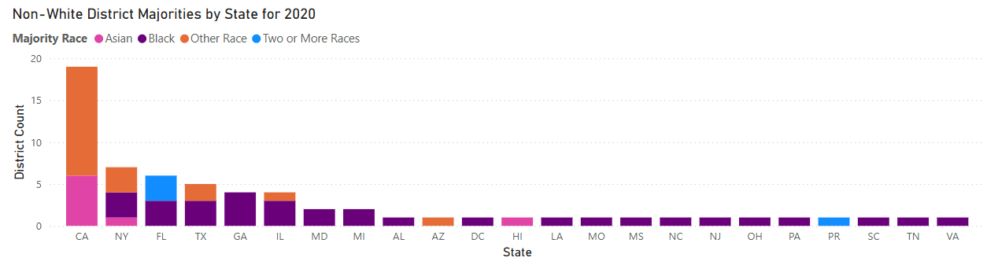
Shifts in District Racial Majorities
21 states had at least one non-white majority district in 2000 compared to 23 in 2020
CA had an increase in Asian and Other Race majority districts, making for 19 non-white districts, up from 5.
Other states with significant increases include FL, TX and GA

Slide 45
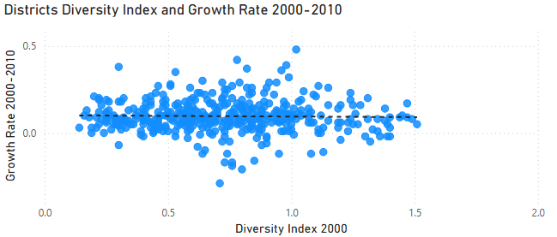
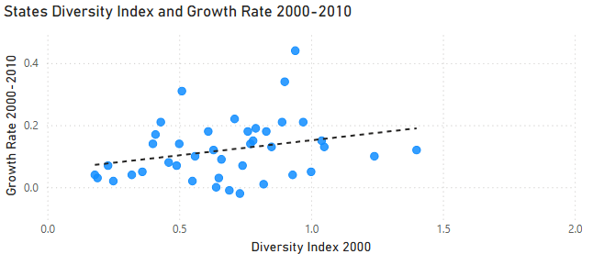
Correlation Between Racial Diversity And Population Growth
Shannon-Wiener diversity index: measure the diversity of racial and ethnic groups in a community
Range: [0, ln7]
Data points fall within the 0-75 percentile range of diversity index, indicating moderate to low diversity.

Slide 46
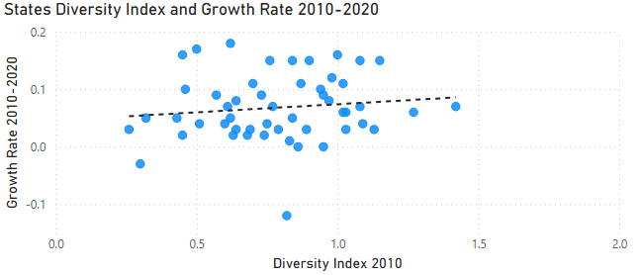
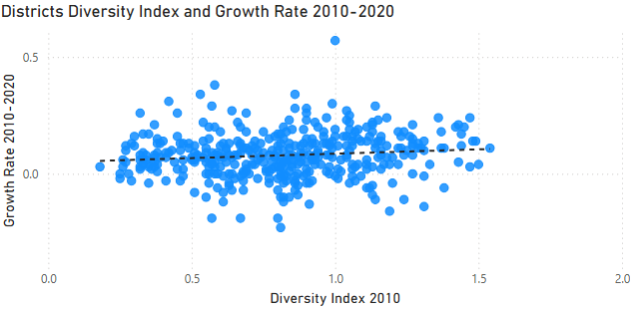
Correlation Between Racial Diversity And Population Growth
Most diverse districts are in California, while least diverse district is in Kentucky
Most diverse states are Hawaii, California while least diverse states are Maine and Vermont
Conclusion: positive correlation between the racial diversity and population growth.

Slide 47
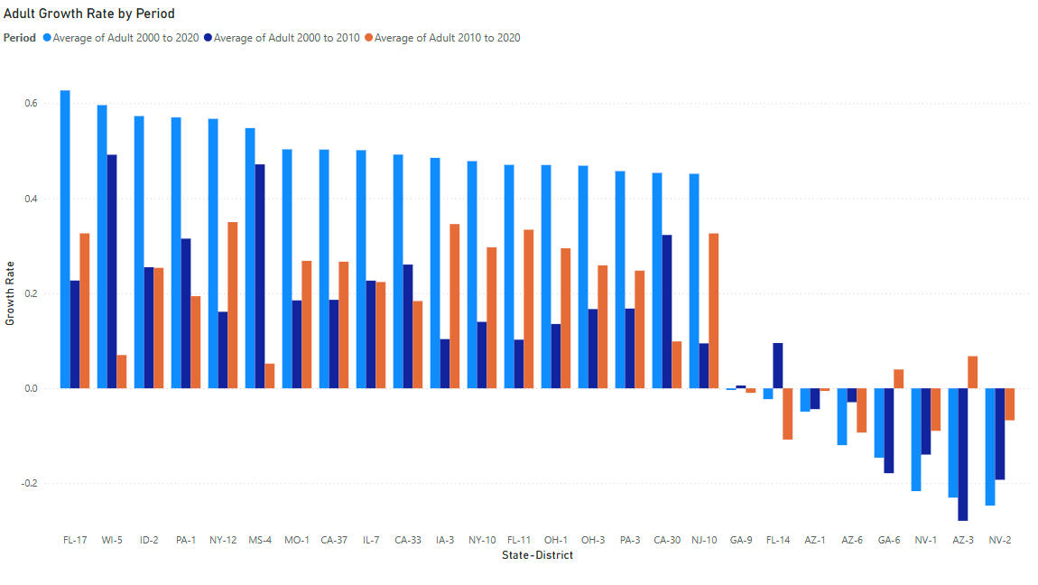
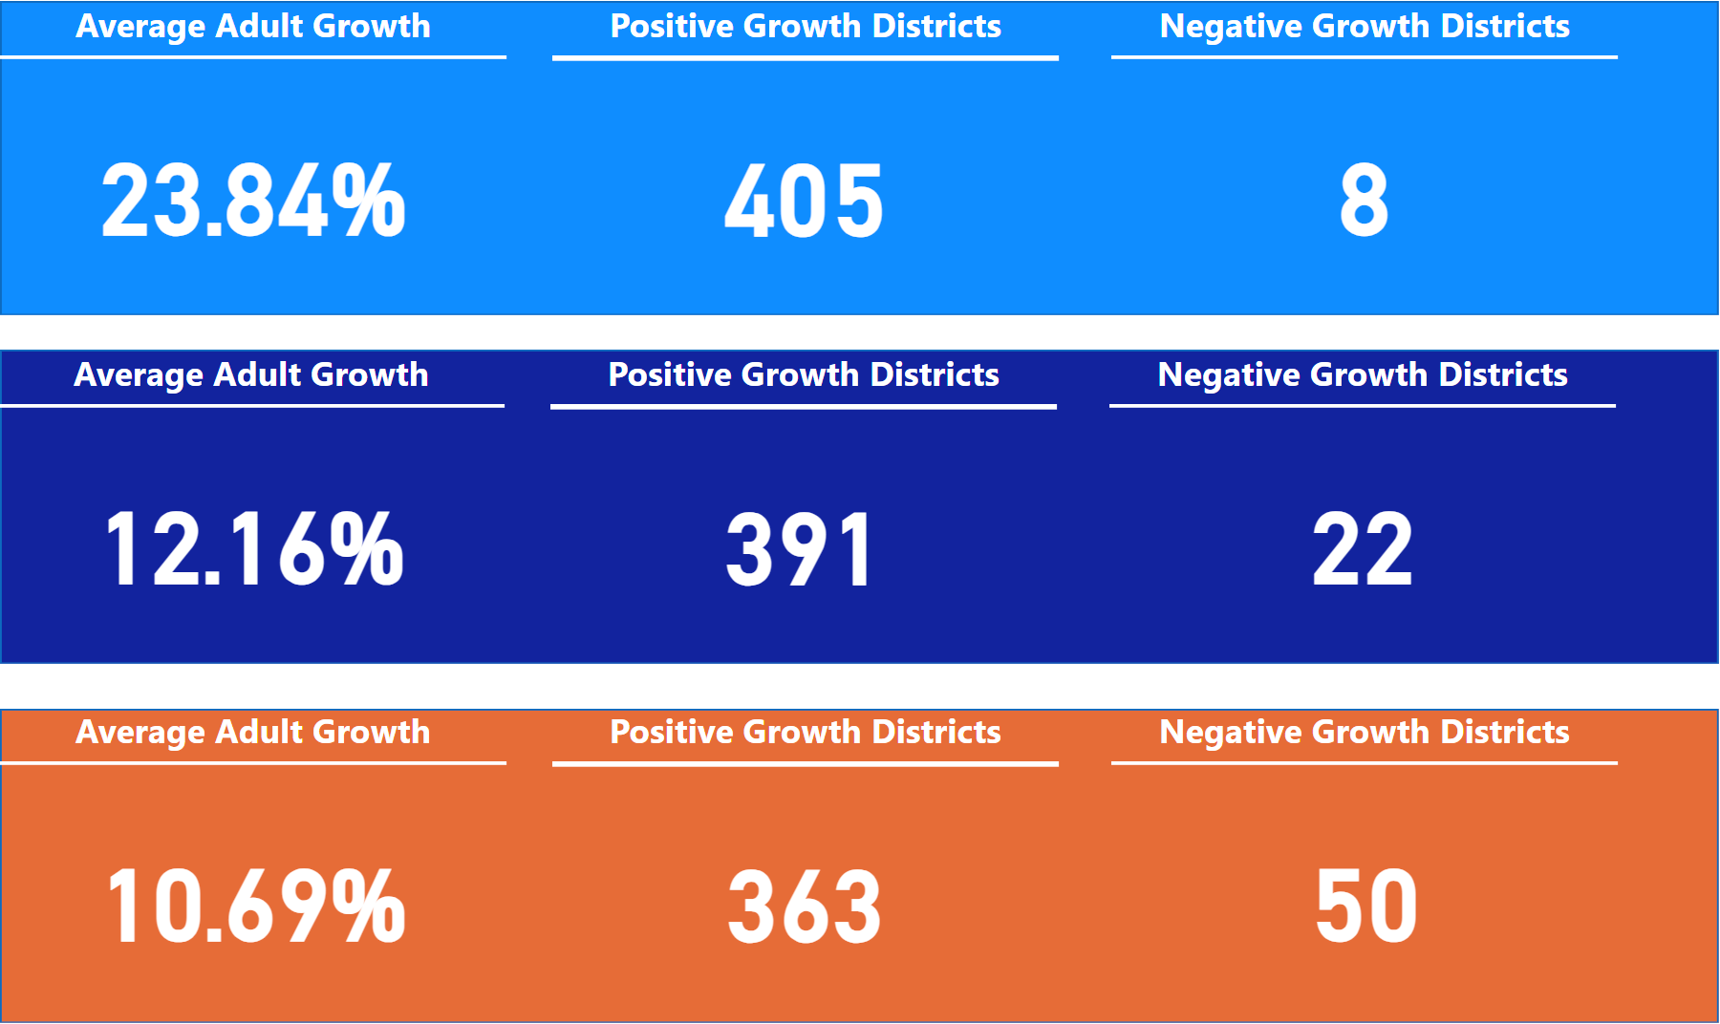
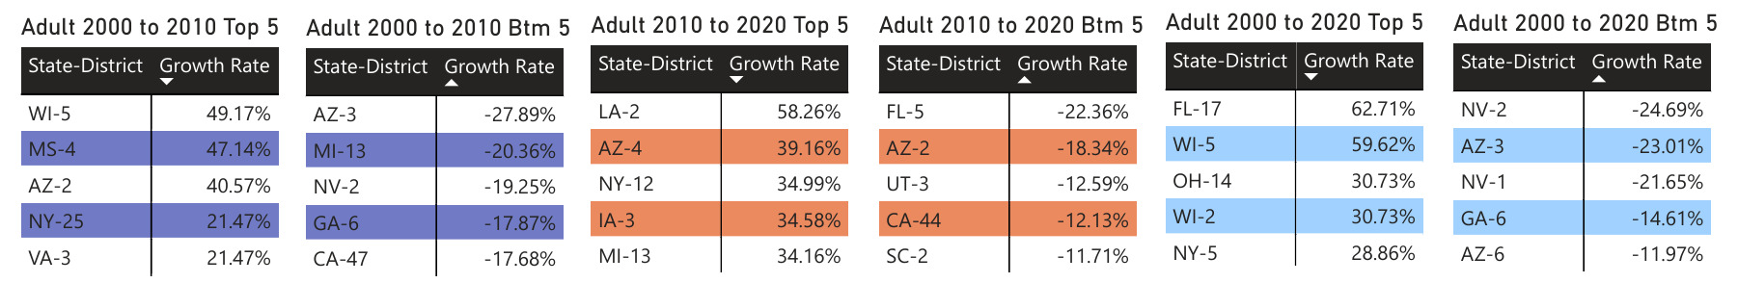
District Growth/Decline Rates by Age Group (Adult)
2000 to 2010
2010 to 2020
2000 to 2020
SHOWN: TOP 18 GROWTH AND ALL DECLINING DISTRICT RATES, SPLIT BY PERIOD (SORTED BY 2000 to 2020 DESCENDING)

Slide 48
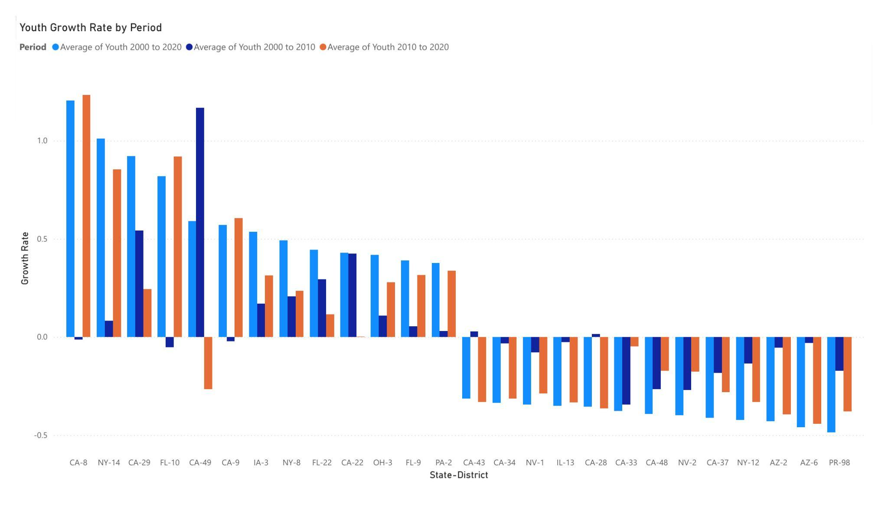
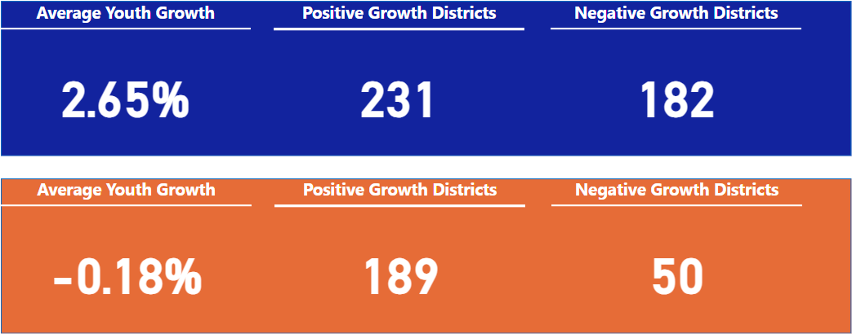
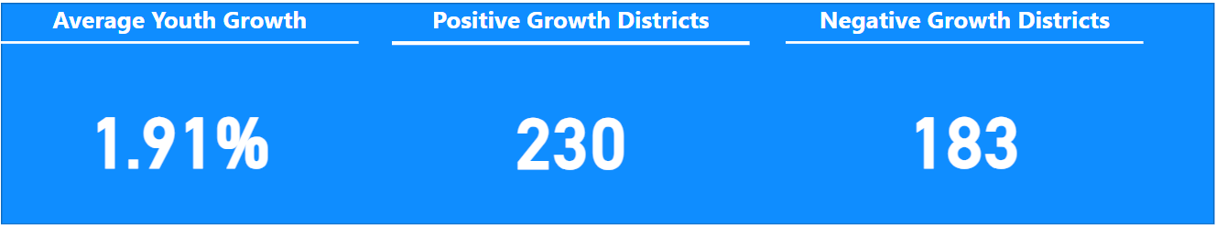
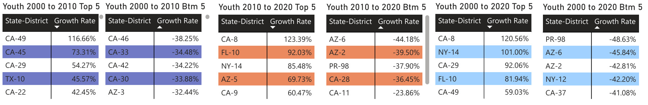
District Growth/Decline Rate by Age Group (Youth)
2000 to 2010
2010 to 2020
2000 to 2020
SHOWN: TOP 13 GROWTH AND BOTTOM 13 DECLINE RATES, SPLIT BY PERIOD (SORTED BY 2000 to 2020 DESCENDING)
SHOWN: TOP 18 GROWTH AND ALL DECLINING DISTRICT RATES, SPLIT BY PERIOD (SORTED BY 2000 to 2020 DESCENDING)

Slide 49
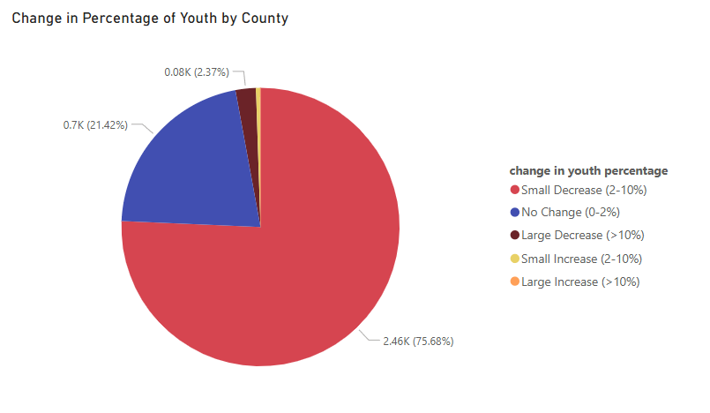
Under 18 Population Shifts by County
Most counties have had a small decrease in percentage of under 18 from 2000 to 2020
About a fifth saw little to no change
80 counties had a large decrease
Only 2 counties had an increase of more than 10% population of under 18

Slide 50
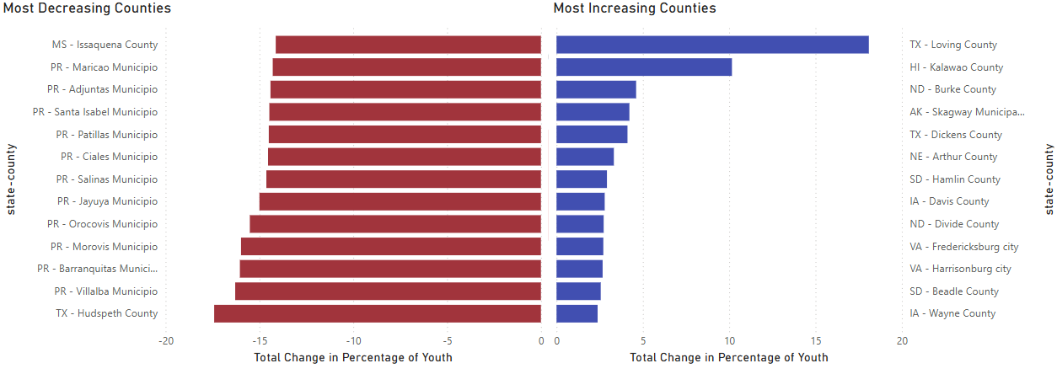
Under 18 Population Shifts by County

Slide 51
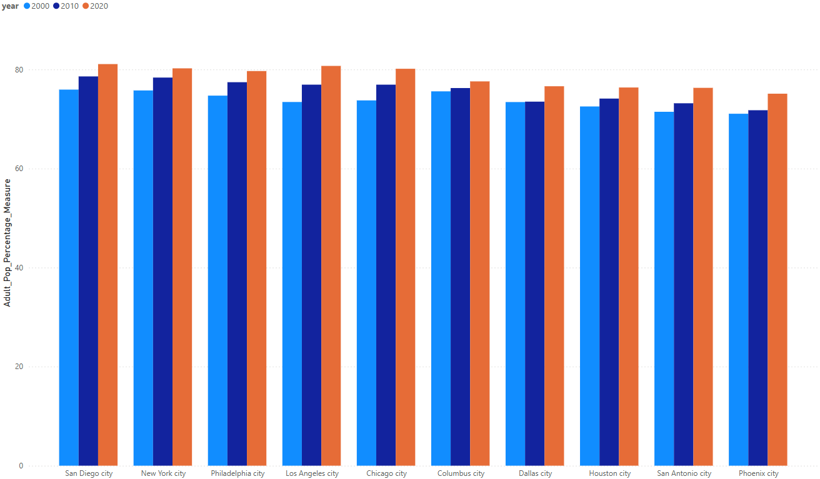
Proportion of adults vs youth by city
Densely populated urban cities have maintained an adult population proportion of 70% or higher over the past three decades.
Economic opportunities may attract working-age adults, while younger populations are in suburban or rural areas.

Slide 52

Proportion of adults vs youth by city
Every city shows a steady increase in adult population percentage from 2000 to 2020, indicating a widespread demographic shift.
The upward trend across all cities suggests factors such as aging-in-place, declining birth rates, job opportunities or migration patterns.

Slide 53
Data Analysis
Regional Comparison

Slide 54

Total Population Growth by Region
The regions strictly increased
South had the most states, population, and change
West had the second most growth
Midwest and Northeast both grew much slower

Slide 55

Total Population Growth by Region
Notes:
The bubble sizes show the numerical population growth and the labels show the percentile population growth. The west has a similar percentage growth to the south, but the south’s larger population means their bubble is larger.

Slide 56

Total Population Growth by Region
Notes:
All regions grew faster from 2000 to 2010 compared to 2010 to 2020 except for the Northeast

Slide 57

Regional Growth Predictions (2020-2030)
+12.69% South
+11.39% West
+3.44% Northeast
+2.89% for Midwest
Notes:
Percent growth was calculated with (total_population - prev_population)/prev_population, but we did not have data for 1990, so the growth rate was calculated for 2010, 2020, and 2030, where we see a drop after 2010 with a slight recovery..

Slide 58


Racial Composition Trends by Region
Asians, Other, and Two or More Races populations experienced the greatest increases in population share over the years.
White population share experienced decreases overall year over year, with 2010-2020 experiencing the greatest drop in white population share, while still maintaining the largest share.
American Indian, Hawaiian, and Black population proportions remained relatively stable year over year for the West, gaining small percentage shares per year.

Slide 59


Racial Composition Trends by Region
Two or More Races population experienced the greatest increases in population share over the years.
White population share experienced decreases overall year over year, with 2010-2020 experiencing the greatest drop in white population share, while still maintaining the largest share.
All other population groups remained relatively stable in the Midwest in terms of population share throughout the years.

Slide 60


Racial Composition Trends by Region
Asian, Other, and Two or More Races population experienced large increases in population share over the years.
White population share experienced decreases overall year over year, with 2010-2020 experiencing the greatest drop in white population share, while still maintaining the largest share.
Black, American Indian, and Hawaiian population groups remained relatively stable in terms of population share throughout the years.

Slide 61


Racial Composition Trends by Region
Asian, Other, and Two or More Races population experienced large increases in population share over the years.
White population share experienced decreases overall year over year, with 2010-2020 experiencing the greatest drop in white population share, while still maintaining the largest share.
Black, American Indian, and Hawaiian population groups remained relatively stable in terms of population share throughout the years, with Black being the second largest group in the South.

Slide 62

Racial Diversification Per Region

Slide 63


Racial Diversification Per Region

Slide 64

Population Growth: Metropolitan vs. Non-Metropolitan
Notes:
Henry

Slide 65

Minority Population Increases Per Region

Slide 66




Minority Population Increases Per Region

Slide 67
Retrospective

Slide 68
Summary
Wrangle legacy U.S. Census data for years 2000, 2010, 2020
Clean data for optimal analysis
Query data based on analyzation questions
Overall National Trends and Growth
Population Trends and Growth
Demographic Shifts
Regional Comparison
Python, Spark (PySpark & Spark SQL), Hadoop, Power BI

Slide 69
Challenges
Evolution of team responsibilities
Limited time to digest the data
Lack of resources towards data validation

Slide 70
The Team
Abdul Tareq Khaliq | Jarrod Saechao | Rui Li
Adeel Hussain | Kimberly Hilke | Ryan Tavares
Aditya Ankaraboyana | Matthew Larson | Sumneet Brar
Eric Hom | Maxine Shi | Tin Ngo
Harish Kandaswamy | Miguel Pena | Vadim Torgashov
Henry Lee | Patrick Carr
Special thanks to our trainer, William Terry

Slide 71
Q&A

